Slide 1

Tutorial: Writing Reports
in Engineering and Science
Additional slides to address common questions from audience
Michael Alley
College of Engineering
Pennsylvania State University
Notes:
This teaching presentation accompanies the Tutorial on Writing Reports in Engineering and Science: https://sites.psu.edu/scientificwriting/tutorial-reports/. This tutorial targets engineering and science students who have not had a strong course in technical writing. In doing so, the tutorial discusses important differences between general writing, which all of the students have studied since grammar school, and technical writing, which many students have not formally studied.
Students are expected to have viewed the tutorial before coming to this class. The content for this tutorial arises from the following portions of The Craft of Scientific Writing, 4th ed. (Alley, Springer, 2018): Introduction, Lesson 1, Lesson 2, and Lesson 7.
Please feel free to modify this file to emphasize the parts of the tutorial that you deem most important. Also, please feel free to add your name as a presenter on this title page.
Tip: Before showing this presentation in your course, be sure to view the file in the slideshow mode so that you can time your animations to follow the answers given by students in the class.

Slide 2
Once you have the content, where should you begin the writing process?
Notes:
This class period consists of the instructor posing questions and the students answering those questions. To use time efficiently, I call on people for the simpler questions and call on volunteers for the more difficult questions. In addition, when the answer is a simple yes or no (or multiple choice), I ask for a show of hands. In my mind, the more people that participate in the discussion, the better that the class period has gone.
This question is answered at the beginning of the film “Analyzing Audience, Purpose, and Occasion.” This question is also answered on page 3 of The Craft of Scientific Writing, 4th ed. (Alley, Springer, 2018).

Slide 3

audience
purpose
occasion
Notes:
This answer comes from the film “Analyzing Audience, Purpose, and Occasion.” This answer also is discussed on page 3 of The Craft of Scientific Writing, 4th ed. (Alley, Springer, 2018).

Slide 4
What are the most important questions to ask about audience?
Notes:
This question is answered in the film “Analyzing Audience, Purpose, and Occasion.” This question is also answered on pages 3-5 of The Craft of Scientific Writing, 4th ed. (Alley, Springer, 2018).
Note that students will often remember the constraint of audience, but not the constraints of purpose and occasion. If someone mentions just “audience,” I commend that person, but then have the audience identify the other two constraints before advancing to the answer.
Michael Alley: Tutorial on Writing Reports

Slide 5
who are they?
what do they know?
why are they reading?
Notes:
This answer comes from the film “Analyzing Audience, Purpose, and Occasion.” This answer also is discussed on pages 3-5 of The Craft of Scientific Writing, 4th ed. (Alley, Springer, 2018).
Note the animation that occurs when viewed in the slideshow mode.

Slide 6
What are the main purposes
of engineering writing?
Notes:
This question is answered in the film “Analyzing Audience, Purpose, and Occasion.” This question is also answered on pages 5-8 of The Craft of Scientific Writing, 4th ed. (Alley, Springer, 2018).
Note that if the audience identifies the purpose of informing, but not persuading, I ask the students to identify a second purpose before advancing.

Slide 7
To persuade
To inform
Notes:
This answer comes from the film “Analyzing Audience, Purpose, and Occasion.” This answer also is discussed on pages 5-8 of The Craft of Scientific Writing, 4th ed. (Alley, Springer, 2018).
Before advancing, I ask the students why the shape of persuasion is a triangle rather than a rectangle—someone should remember that all technical documents carry the purpose of informing, but technical documents carry different levels of persasion.

Slide 8
How does persuasion
affect the style?
Notes:
This question is answered in the film “Analyzing Audience, Purpose, and Occasion.” This question is also answered on page 8 of The Craft of Scientific Writing, 4th ed. (Alley, Springer, 2018).

Slide 9

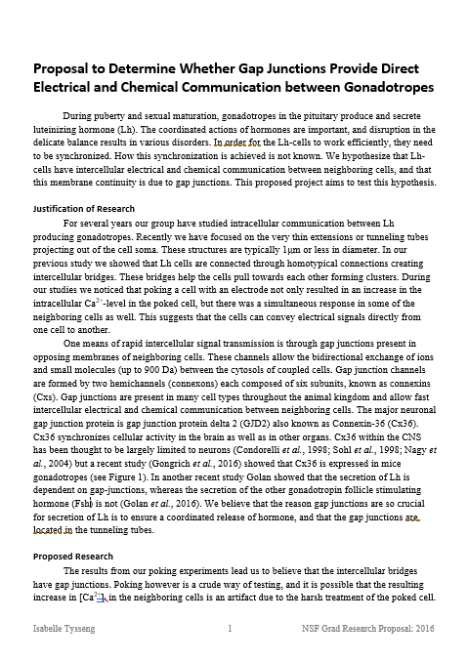
Notes:
This answer comes from the film “Analyzing Audience, Purpose, and Occasion.” This answer also is discussed on page 8 of The Craft of Scientific Writing, 4th ed. (Alley, Springer, 2018).

Slide 10
What does the word
format mean?
Notes:
This question is answered in the film “Analyzing Audience, Purpose, and Occasion.” This question is also answered on page 11 of The Craft of Scientific Writing, 4th ed. (Alley, Springer, 2018).
Michael Alley: Tutorial on Writing Reports

Slide 11
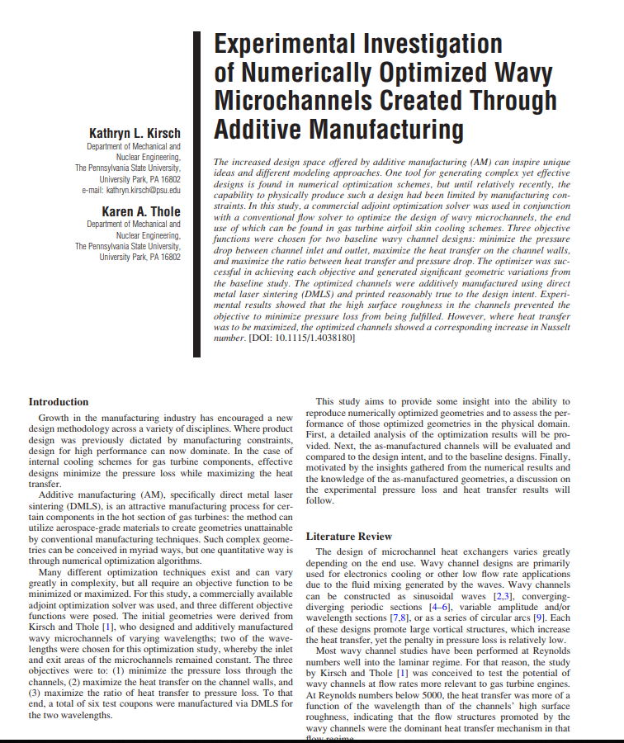
Notes:
This answer comes from the film “Analyzing Audience, Purpose, and Occasion.” This answer also is discussed on page 11 of The Craft of Scientific Writing, 4th ed. (Alley, Springer, 2018).

Slide 12
Is there a universal format in scientific writing?
Notes:
This question is answered in the film “Analyzing Audience, Purpose, and Occasion.” This question is also answered on page 11 of The Craft of Scientific Writing, 4th ed. (Alley, Springer, 2018).
Because this question is a “yes or no” question, I ask students to raise their hands. If students are looking to see how others are voting, I will have them close their eyes when they are ready to vote and then report what the breakdown was. I will often ask someone, usually someone who is correct, to defend his or her answer

Slide 13
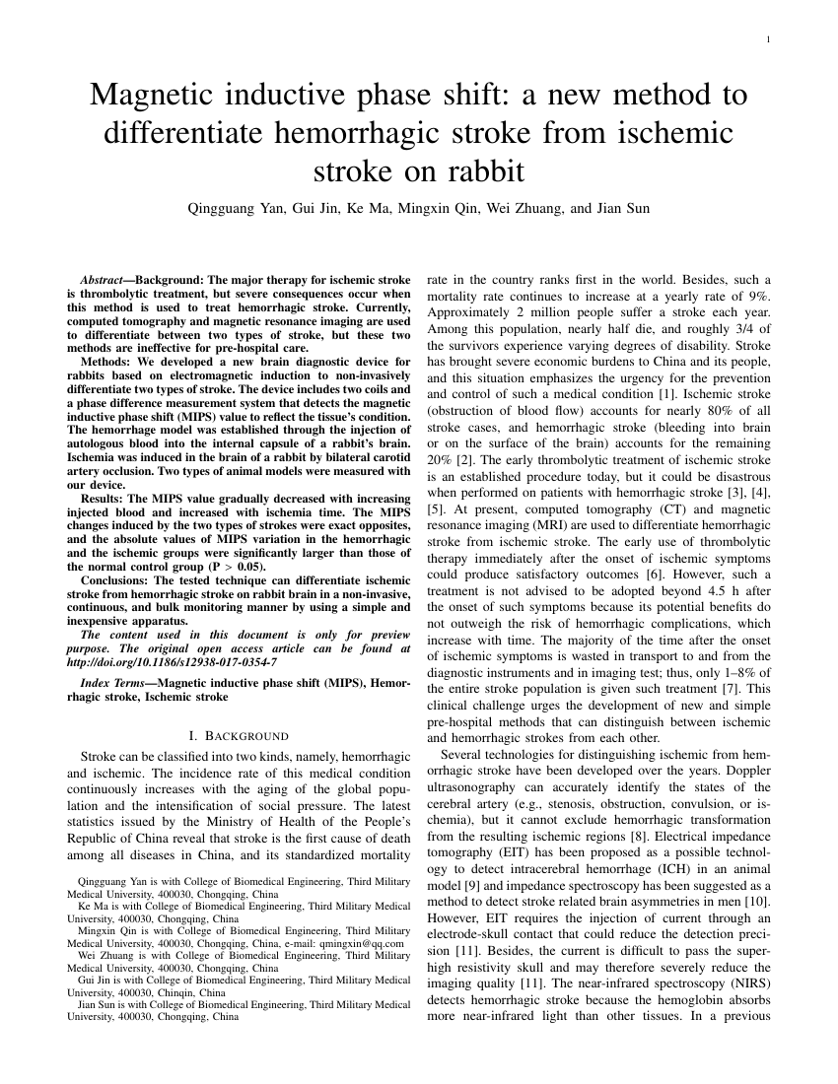
ASME
IEEE
Notes:
This answer comes from the film “Analyzing Audience, Purpose, and Occasion.” This answer also is discussed on page 11 of The Craft of Scientific Writing, 4th ed. (Alley, Springer, 2018).

Slide 14
Structure
of Reports
Notes:
Because the class period can be intense, particularly if you are calling on specific people, consider giving the students a break by announcing that the next portion of the tutorial will be the portion on structure. Then give the students a minute to discuss with a partner the most important takeaways of this portion. In my classes, the discussion is energetic because the students who did not view the tutorial are eager to learn answers. The discussion also provides a nice break from the question-and-answer rhythm and allows everyone the chance to say something about the films.

Slide 15
What makes for an effective title?
Notes:
This question is answered in the film “Title of a Report.” This question is also answered on pages 110-114 of The Craft of Scientific Writing, 4th ed. (Alley, Springer, 2018).

Slide 16
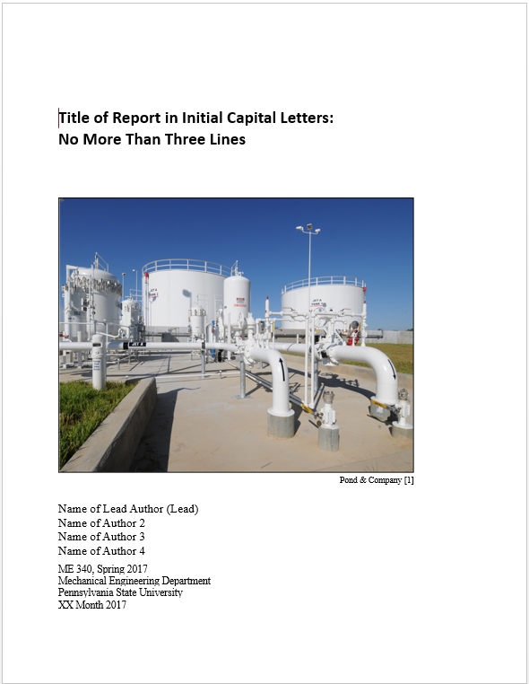
A title should identify the scope of the document and
separate that document from other documents
Title of Document
Notes:
This answer comes from the film “Title of a Report.” This answer also is discussed on pages 110-114 of The Craft of Scientific Writing, 4th ed. (Alley, Springer, 2018).

Slide 17
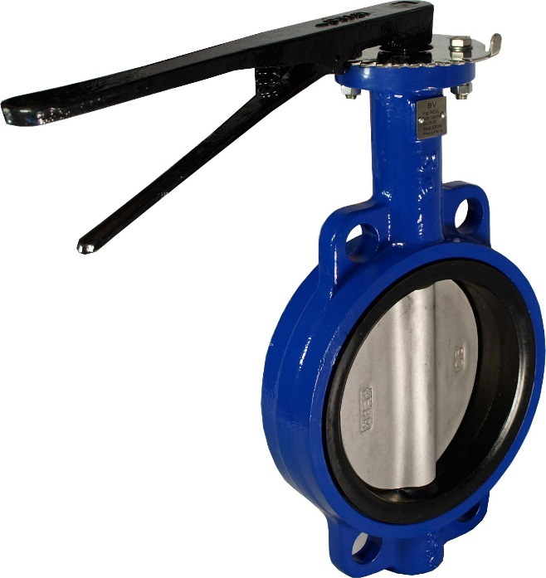

Exercise: Discuss a title for a report on the initial research of a design project for the valve described below
Mix Tanks
[brookvalves.com.ad]
[gemak.co.uk]
Butterfly Valve
Yogurt Facility
Notes:
This type of question is discussed in the film “Title of a Report.” This type of question is also discussed on pages 110-114 of The Craft of Scientific Writing, 4th ed. (Alley, Springer, 2018).
Websites for Images:
http://brookvalves.com.au/images/products/59.jpg
http://gemak.co.uk/wp-content/uploads/2014/10/Mix-Tanks-for-yogurt-and-Ice-Cream.jpg

Slide 18
For the situation given, what would be the best title
for a report that is parallel to the one you are writing?
ME Report #1
Butterfly Valves
Butterfly Yogurt: A New Flavor of Valves
Yogurt Facility Mix Tank Butterfly Valves Research
Initial Research on Butterfly Valves for the Mix Tanks
at a Yogurt Facility
Notes:
This type of question is discussed in the film “Title of a Report.” This type of question is also discussed on pages 110-114 of The Craft of Scientific Writing, 4th ed. (Alley, Springer, 2018).

Slide 19
Titles of engineering reports are typically longer and
more informative than titles in creative writing
ME Report #1
Butterfly Valves
Butterfly Yogurt: A New Flavor of Valves
Yogurt Facility Mix Tank Butterfly Valves Research
Initial Research on Butterfly Valves for the Mix Tank
at a Yogurt Facility
Notes:
This type of question is discussed in the film “Title of a Report.” This type of question is also discussed on pages 110-114 of The Craft of Scientific Writing, 4th ed. (Alley, Springer, 2018).

Slide 20
Why do we have summaries in engineering writing?
Notes:
This question is discussed in the film “Summary of a Report.” This question is also discussed on pages 139-143 of The Craft of Scientific Writing, 4th ed. (Alley, Springer, 2018).

Slide 21
Notes:
This question is discussed in the film “Summary of a Report.” This question is also discussed on pages 139-143 of The Craft of Scientific Writing, 4th ed. (Alley, Springer, 2018).

Slide 22
True or False?
Every idea in the summary should occur in at least that much detail in the document’s main text
Notes:
This question is discussed in the film “Summary of a Report.” This question is also discussed on pages 139-143 of The Craft of Scientific Writing, 4th ed. (Alley, Springer, 2018).

Slide 23
True
Every idea in the summary should occur in at least that much detail in the document’s main text
Notes:
This answer is discussed in the film “Summary of a Report.” This answer is also discussed on pages 139-143 of The Craft of Scientific Writing, 4th ed. (Alley, Springer, 2018).

Slide 24
Why do we write
in sections?
Notes:
This question is discussed in the film “Middle of a Report: Writing in Sections.” This question is also discussed on pages 121-128 of The Craft of Scientific Writing, 4th ed. (Alley, Springer, 2018).

Slide 25
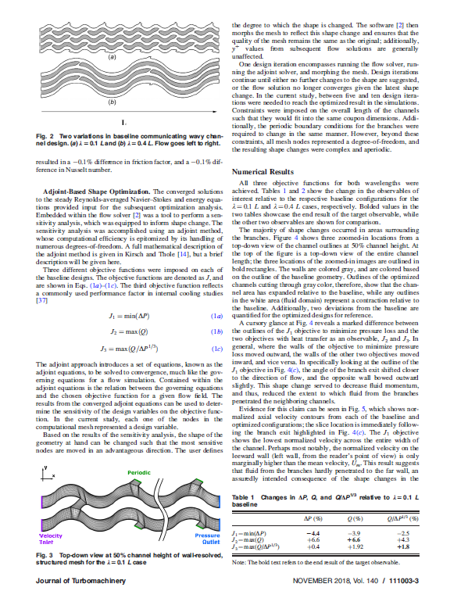
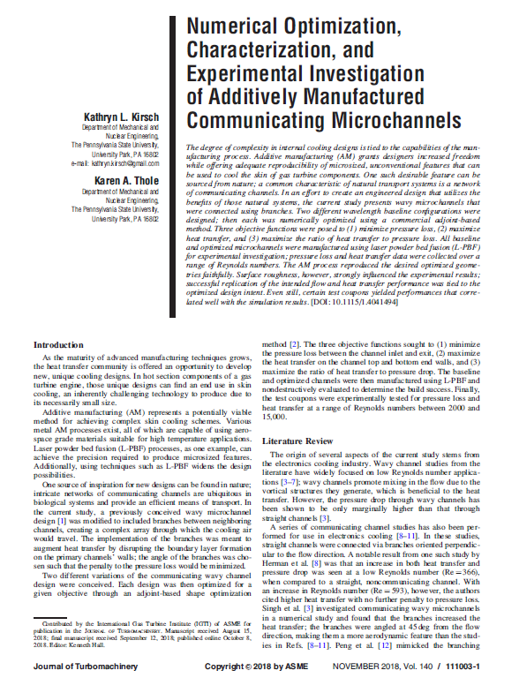
Notes:
This question is discussed in the film “Middle of a Report: Writing in Sections.” This question is also discussed on pages 121-128 of The Craft of Scientific Writing, 4th ed. (Alley, Springer, 2018).

Slide 26
What are the two main ways that we begin a section?
Notes:
This question is discussed in the film “Middle of a Report: Writing in Sections.” This question is also discussed on pages 94-97 of The Craft of Scientific Writing, 4th ed. (Alley, Springer, 2018).

Slide 27
Introduction
This document presents the design of a small wind turbine to provide power for lighting in remote areas without access to an electrical grid.…
Notes:
This answer is discussed in the film “Middle of a Report: Writing in Sections.” This answer is also discussed on pages 94-97 of The Craft of Scientific Writing, 4th ed. (Alley, Springer, 2018).

Slide 28
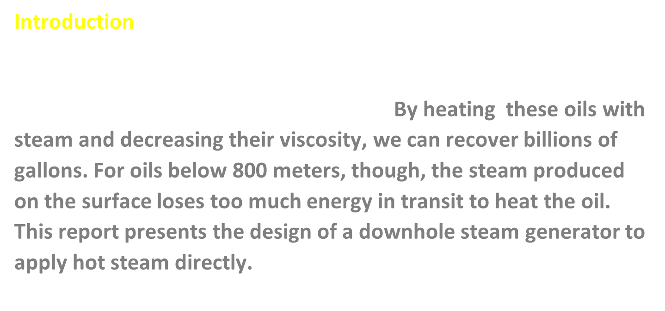
Notes:
This answer is discussed in the film “Middle of a Report: Writing in Sections.” This answer is also discussed on pages 94-97 of The Craft of Scientific Writing, 4th ed. (Alley, Springer, 2018).

Slide 29

What is a general strategy for the opening of a section in scientific writing?
A → B
Notes:
This question is discussed in the film “Middle of a Report: Writing in Sections.” This question is also discussed on pages 94-97 of The Craft of Scientific Writing, 4th ed. (Alley, Springer, 2018).

Slide 30
Language
of Reports
Notes:
Because the class period can be intense, particularly if you are calling on specific people, consider giving the students a break by announcing that the next portion of the tutorial will be the portion on language, which is writing at the sentence and paragraph levels. Then give the students a minute to discuss with a partner the most important takeaways of this portion. In my classes, the discussion is energetic because the students who did not view the tutorial are eager to learn answers. The discussion also provides a nice break from the question-and-answer rhythm and allows everyone the chance to say something about the films.

Slide 31
At the sentence level, what is (are) the most important goal(s)?
To be __________?
Notes:
This question is discussed in the film “Language: Being Precise and Clear.” This question is also discussed on page 15 of The Craft of Scientific Writing, 4th ed. (Alley, Springer, 2018).
More detail about being precise and being clear can be found in Lesson 2 of The Craft of Scientific Writing, 4th ed. (Alley, Springer, 2018) and the films of Lesson 2: Being Precise and Clear (https://www.craftofscientificwriting.com/lesson_2.html).

Slide 32
be precise
be clear
Notes:
This question is discussed in the film “Language: Being Precise and Clear.” This question is also discussed on page 15 of The Craft of Scientific Writing, 4th ed. (Alley, Springer, 2018).
More detail about being precise and being clear can be found in Lesson 2 of The Craft of Scientific Writing, 4th ed. (Alley, Springer, 2018) and the films of Lesson 2: Being Precise and Clear (https://www.craftofscientificwriting.com/lesson_2.html).

Slide 33
What place does exaggeration have in scientific writing?
Notes:
This question is discussed in the film “Language: Being Precise and Clear.” This question is also discussed on page 15 of The Craft of Scientific Writing, 4th ed. (Alley, Springer, 2018).
More detail about being precise and being clear can be found in Lesson 2 of The Craft of Scientific Writing, 4th ed. (Alley, Springer, 2018) and the films of Lesson 2: Being Precise and Clear (https://www.craftofscientificwriting.com/lesson_2.html).

Slide 34
Notes:
A blank slide is shown here because exaggeration has no place in scientific writing.

Slide 35
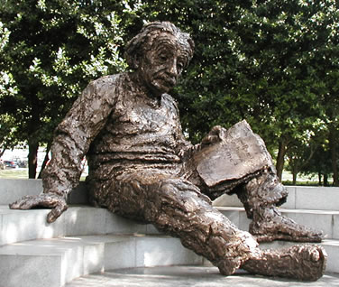
What was the quotation
by Einstein?
Notes:
This question is discussed in the film “Language: Being Precise and Clear.” This question is also discussed on page 15 of The Craft of Scientific Writing, 4th ed. (Alley, Springer, 2018).
More detail about being precise and being clear can be found in Lesson 2 of The Craft of Scientific Writing, 4th ed. (Alley, Springer, 2018) and the films of Lesson 2: Being Precise and Clear (https://www.craftofscientificwriting.com/lesson_2.html).

Slide 36
Keep things as simple as possible, yet no simpler
Notes:
This quotation is discussed in the film “Language: Being Precise and Clear.” This question is also discussed on page 15 of The Craft of Scientific Writing, 4th ed. (Alley, Springer, 2018).
More detail about being precise and being clear can be found in Lesson 2 of The Craft of Scientific Writing, 4th ed. (Alley, Springer, 2018) and the films of Lesson 2: Being Precise and Clear (https://www.craftofscientificwriting.com/lesson_2.html).

Slide 37
What did Einstein mean by
“yet no simpler”?
Notes:
This question is discussed in the film “Language: Being Precise and Clear.” This question is also discussed on page 15 of The Craft of Scientific Writing, 4th ed. (Alley, Springer, 2018).
More detail about being precise and being clear can be found in Lesson 2 of The Craft of Scientific Writing, 4th ed. (Alley, Springer, 2018) and the films of Lesson 2: Being Precise and Clear (https://www.craftofscientificwriting.com/lesson_2.html).

Slide 38
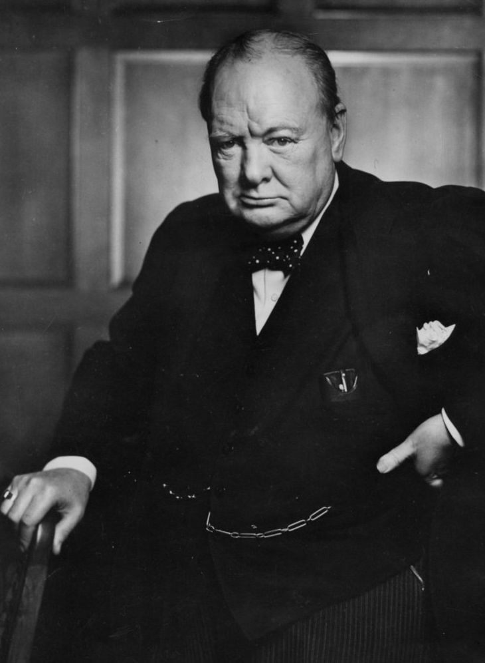
What was the quotation
by Churchill?
Notes:
This question is discussed in the film “Language: Being Precise and Clear.” This question is also discussed on page 22 of The Craft of Scientific Writing, 4th ed. (Alley, Springer, 2018).
More detail about being precise and being clear can be found in Lesson 2 of The Craft of Scientific Writing, 4th ed. (Alley, Springer, 2018) and the films of Lesson 2: Being Precise and Clear (https://www.craftofscientificwriting.com/lesson_2.html).

Slide 39
Short words are best, and old words, when short, are best of all.
Notes:
This quotation is discussed in the film “Language: Being Precise and Clear.” This question is also discussed on page 22 of The Craft of Scientific Writing, 4th ed. (Alley, Springer, 2018).
More detail about being precise and being clear can be found in Lesson 2 of The Craft of Scientific Writing, 4th ed. (Alley, Springer, 2018) and the films of Lesson 2: Being Precise and Clear (https://www.craftofscientificwriting.com/lesson_2.html).

Slide 40

What was the quotation
by Bernstein?
Notes:
This question is discussed in the film “Language: Being Precise and Clear.” This question is also discussed on page 26 of The Craft of Scientific Writing, 4th ed. (Alley, Springer, 2018).
More detail about being precise and being clear can be found in Lesson 2 of The Craft of Scientific Writing, 4th ed. (Alley, Springer, 2018) and the films of Lesson 2: Being Precise and Clear (https://www.craftofscientificwriting.com/lesson_2.html).

Slide 41
One idea,
one sentence.
Notes:
This quotation is discussed in the film “Language: Being Precise and Clear.” This question is also discussed on page 26 of The Craft of Scientific Writing, 4th ed. (Alley, Springer, 2018).
More detail about being precise and being clear can be found in Lesson 2 of The Craft of Scientific Writing, 4th ed. (Alley, Springer, 2018) and the films of Lesson 2: Being Precise and Clear (https://www.craftofscientificwriting.com/lesson_2.html).

Slide 42
What is an ambiguity?
Notes:
This question is discussed in the film “Language: Avoiding Ambiguity.” This question is also discussed on page 37 of The Craft of Scientific Writing, 4th ed. (Alley, Springer, 2018).
More detail about avoiding ambiguity can be found in Lesson 3 of The Craft of Scientific Writing, 4th ed. (Alley, Springer, 2018) and the films of Lesson 3: Avoiding Ambiguity (https://www.craftofscientificwriting.com/lesson_3.html).

Slide 43
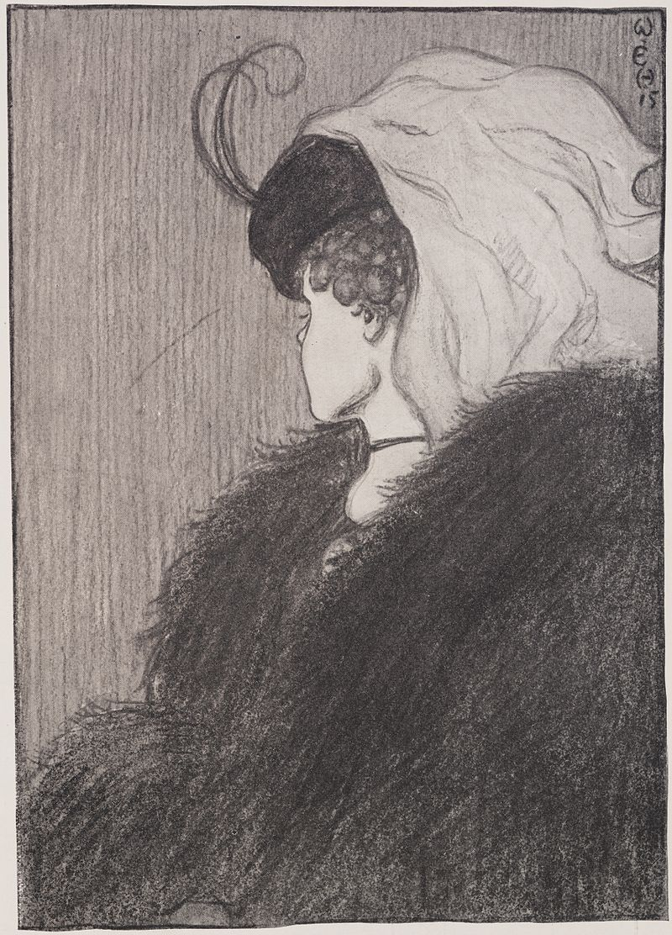
Notes:
This image is discussed in the film “Language: Avoiding Ambiguity.” A similar image is also discussed on pages 37-38 of The Craft of Scientific Writing, 4th ed. (Alley, Springer, 2018).
More detail about avoiding ambiguity can be found in Lesson 3 of The Craft of Scientific Writing, 4th ed. (Alley, Springer, 2018) and the films of Lesson 3: Avoiding Ambiguity (https://www.craftofscientificwriting.com/lesson_3.html).

Slide 44
What place does ambiguity have in scientific writing?
Notes:
This question is discussed in the film “Language: Avoiding Ambiguity.” This question is also discussed on page 37 of The Craft of Scientific Writing, 4th ed. (Alley, Springer, 2018).
More detail about avoiding ambiguity can be found in Lesson 3 of The Craft of Scientific Writing, 4th ed. (Alley, Springer, 2018) and the films of Lesson 3: Avoiding Ambiguity (https://www.craftofscientificwriting.com/lesson_3.html).
Michael Alley: Tutorial on Writing Reports

Slide 45
Notes:
This slide is blank because ambiguity has no place in scientific or engineering writing.

Slide 46
What are three sources of ambiguities in scientific writing?
Notes:
This question is discussed in the film “Language: Avoiding Ambiguity.” This question is also discussed in Lesson 3 of The Craft of Scientific Writing, 4th ed. (Alley, Springer, 2018).
More detail about avoiding ambiguity can be found in the films of Lesson 3: Avoiding Ambiguity (https://www.craftofscientificwriting.com/lesson_3.html).

Slide 47
In scientific writing, when you want the meaning of “because,” write because, not as
Notes:
This assertion is discussed in the film “Language: Avoiding Ambiguity.” This assertion is also discussed on page 40 of The Craft of Scientific Writing, 4th ed. (Alley, Springer, 2018).
More detail about avoiding ambiguity can be found in Lesson 3 of The Craft of Scientific Writing, 4th ed. (Alley, Springer, 2018) and the films of Lesson 3: Avoiding Ambiguity (https://www.craftofscientificwriting.com/lesson_3.html).

Slide 48
In scientific writing, you should place a comma
after an introductory phrase or clause
Notes:
This assertion is discussed in the film “Language: Avoiding Ambiguity.” This assertion is also discussed on pages 44-45 of The Craft of Scientific Writing, 4th ed. (Alley, Springer, 2018).
More detail about avoiding ambiguity can be found in Lesson 3 of The Craft of Scientific Writing, 4th ed. (Alley, Springer, 2018) and the films of Lesson 3: Avoiding Ambiguity (https://www.craftofscientificwriting.com/lesson_3.html).

Slide 49

Notes:
This assertion is discussed in the film “Language: Avoiding Ambiguity.” This assertion is also discussed on pages 42-44 of The Craft of Scientific Writing, 4th ed. (Alley, Springer, 2018).
More detail about avoiding ambiguity can be found in Lesson 3 of The Craft of Scientific Writing, 4th ed. (Alley, Springer, 2018) and the films of Lesson 3: Avoiding Ambiguity (https://www.craftofscientificwriting.com/lesson_3.html).

Slide 50
What expectations does an audience have for the incorporation of an illustration?
Notes:
This question is addressed in the film “Incorporating Illustration.” This question is also discussed on pages 88-92 of The Craft of Scientific Writing, 4th ed. (Alley, Springer, 2018).

Slide 51
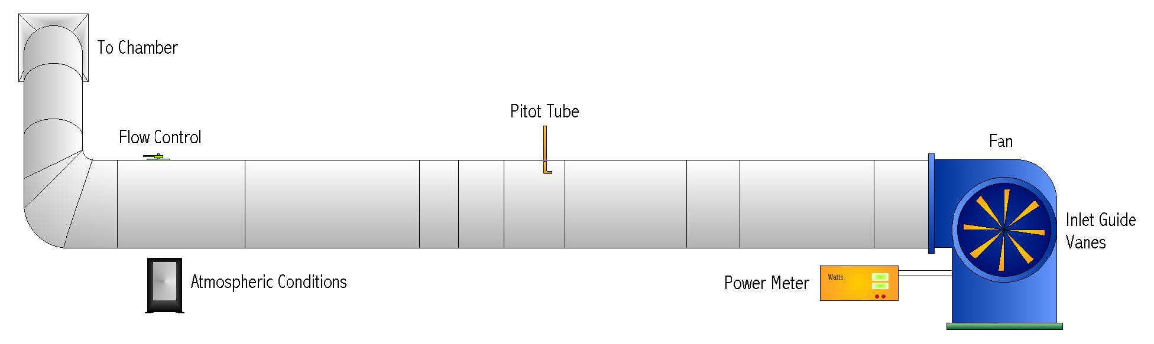
Each illustration should be introduced by name, captioned, explained, and properly placed
..., as shown in Figure 4.
Figure 4. Title of figure [3]. Some formats allow you extra sentences
to explain unusual details. Our format is one such format.
Notes:
This question is addressed in the film “Incorporating Illustrations.” This question is also discussed on pages 88-92 of The Craft of Scientific Writing, 4th ed. (Alley, Springer, 2018).
This slide serves to show students the convention for introducing illustrations into a formal document. That convention is that the author introduce the illustration by name in the text before the illustration appears on the page. Moreover, each illustration besides having a formal name has a caption (in the case of figures) or a heading (in the case of tables). While formats for these names and captions vary, the convention for formal documents does not (some students become confused because informal documents such as brochures and fliers do not have formal names for illustrations). Be sure to practice with the animation so that you know what comes next.

Slide 52
What expectations does an audience have for the incorporation of an equation?
Notes:
This question is addressed in the film “Incorporating Equations.” This question is also discussed on pages 86-88 and 276 of The Craft of Scientific Writing, 4th ed. (Alley, Springer, 2018).

Slide 53
While illustrations appear after the paragraph, equations appear within the paragraph
The strain, ε, was found from equation 1:
where σ is the stress estimated by the computer code, and E is the modulus of elasticity of aluminum.
σ
ε
=
,
(1)
E
Notes:
This question is addressed in the film “Incorporating Equations.” This question is also discussed on pages 86-88 and 276 of The Craft of Scientific Writing, 4th ed. (Alley, Springer, 2018).

Slide 54
Tutorial: Writing Reports
in Engineering and Science
Additional slides to address common questions from audience
Michael Alley
College of Engineering
Pennsylvania State University
Notes:
This teaching presentation accompanies the Tutorial on Writing Reports in Engineering and Science: https://sites.psu.edu/scientificwriting/tutorial-reports/. This tutorial targets engineering and science students who have not had a strong course in technical writing. In doing so, the tutorial discusses important differences between general writing, which all of the students have studied since grammar school, and technical writing, which many students have not formally studied.
Students are expected to have viewed the tutorial before coming to this class. The content for this tutorial arises from the following portions of The Craft of Scientific Writing, 4th ed. (Alley, Springer, 2018): Introduction, Lesson 1, Lesson 2, and Lesson 7.
Please feel free to modify this file to emphasize the parts of the tutorial that you deem most important. Also, please feel free to add your name as a presenter on this title page.
Tip: Before showing this presentation in your course, be sure to view the file in the slideshow mode so that you can time your animations to follow the answers given by students in the class.

