Slide 1
Alexis Jackson, Senior EE
My College of Engineering Experience
Notes:
Hello, everyone. My name is Alexis Jackson and I am a Senior in Electrical Engineering. I am going to speak to you about my Penn State Experience.
*Note: The words on these pages represent what Alexis might say. She did not actually memorize the words, but did learn the sequence of ideas and then fashioned sentences on the spot to present those ideas.

Slide 2
Pre-College
Housing
First-Year
Engagement
Involvement Opportunities
Internships and Coops
World Class Engineer
+
PSU Potential
PSU Potential
-
Notes:
All of us are here for a reason. You have been accepted to Penn State for a reason, which means you have the necessary skills to one day become a world class engineer. However, you have to take advantage of some of the great opportunities Penn State has to offer.
Let’s start with the opportunities that I was able to experience before I officially started my first Fall semester.

Slide 3
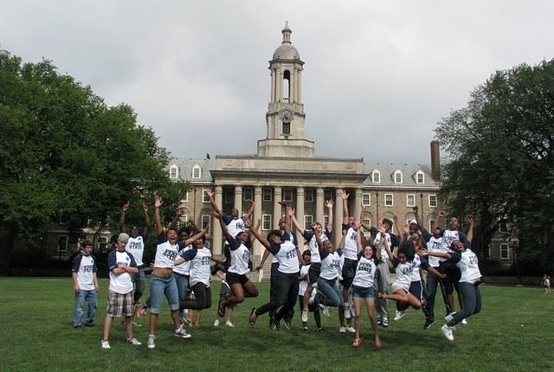
PREF: Pre-First Year in Engineering
Notes:
PREF is Pre First Year in Engineering which is a six-week program that gives students exposure in college prep classes including your calculus, physics and chemistry classes.

Slide 4
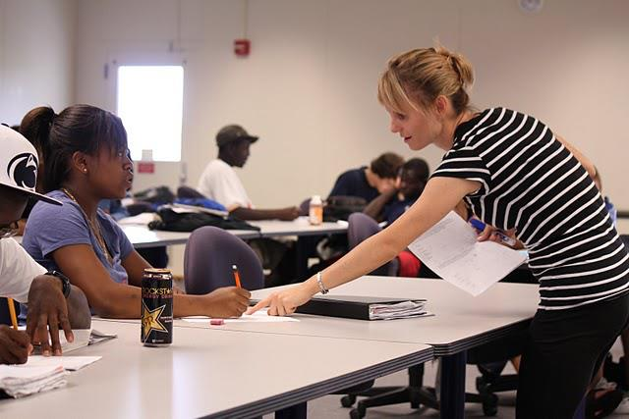
PREF: Pre-First Year in Engineering
Notes:
During PREF, my calculus class was taught by the professor whom I ended up having for Calc 1 and Calc 2. This program gave me exposure to the course load that I could expect in engineering and how the tests were structured.

Slide 5
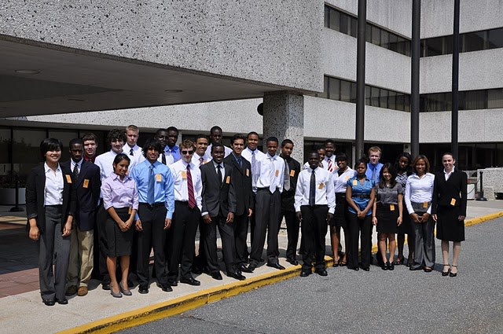
PREF: Pre-First Year in Engineering
Notes:
We also were given corporate interactions in which we were able to visit Air Products. They showed us different chemistry experiments such as making ice cream out of nitrogen. For some reason, I wasn’t the happiest person.

Slide 6
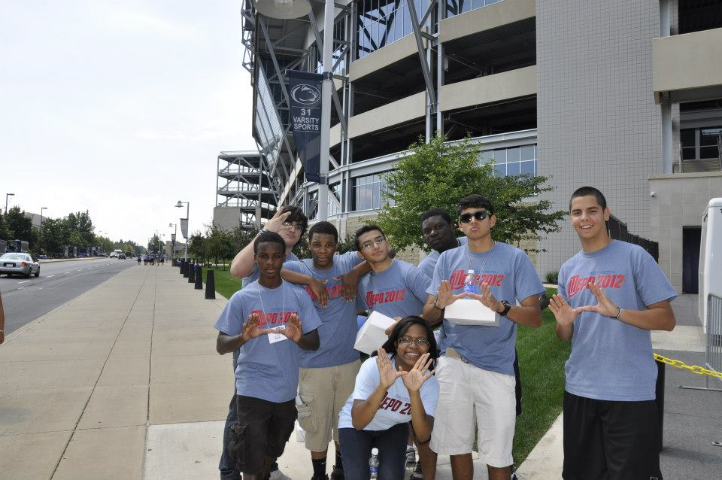
Multicultural Engineering Program Orientation
Notes:
Another program is MEPO, which is three-day multicultural engineering program orientation. Teams work together in a variety of tasks. For example, my team was the winner for the engineering themed amazing race through campus.

Slide 7
Multicultural Engineering Program Orientation
Notes:
All of the teams are broken up into themes. One year we had an iron man theme.

Slide 8
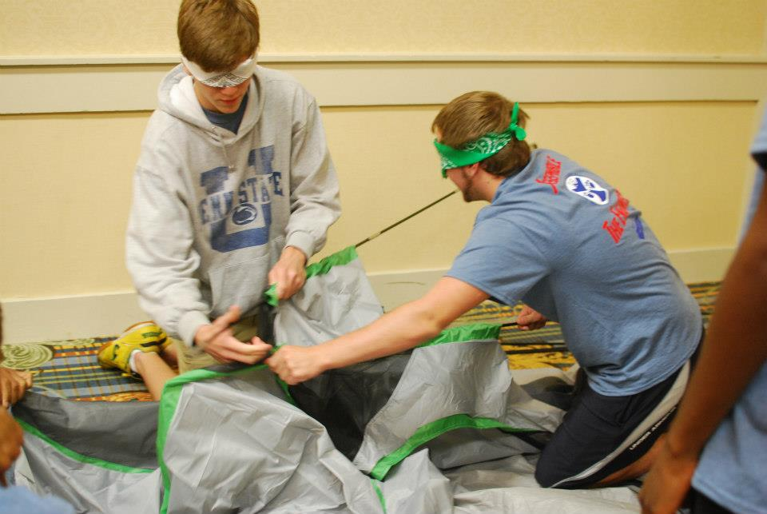
Multicultural Engineering Program Orientation
Notes:
Another one of the staple projects that we do is building a tent. You have majority of your team blindfolding while the other people are directing you on how to create the tent. It emphasizes communication skills and working together. We have a design project as well.

Slide 9
Pre-College
Housing
First-Year
Engagement
Involvement Opportunities
Internships and Coops
World Class Engineer
+
PSU Potential
PSU Potential
-
Notes:
Another detail you have to determine before the fall semester is…

Slide 10
Pre-College
Housing
First-Year
Engagement
Involvement Opportunities
Internships and Coops
World Class Engineer
+
PSU Potential
PSU Potential
-
Notes:
…housing. Penn State offers a variety of special living options (SLOs). A SLO allows for you to live with people in either engineering or a science background.

Slide 11
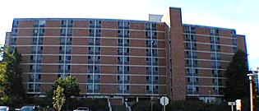
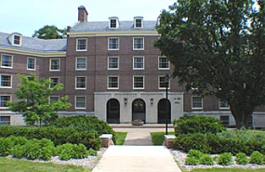
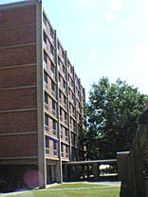
Housing
FISE
E-House
EASI
Notes:
Penn state currently have 3 major SLOs for engineers:
E-house which is located in West Hall
Engineering and applied science interest in Pollock Hall
First year in science and engineering in East Hall

Slide 12
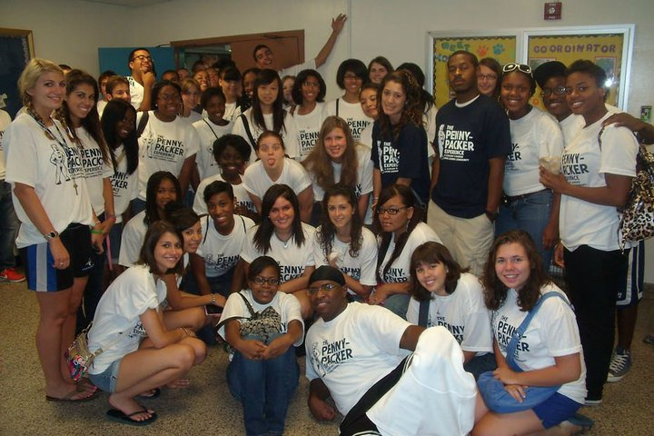
Pennypacker Experience
Notes:
I got to live in Pennypacker Hall, which is a part of East Halls. One of the best parts of my dorm was the fact that we had tutors in the lobby of our building. Instead of having a television, we would have tutors in calculus, physics and chemistry on different days of the week. I would just go down to the lobby in my pajamas if I ever needed help.

Slide 13
Pre-College
Housing
First-Year
Engagement
Involvement Opportunities
Internships and Coops
World Class Engineer
+
PSU Potential
PSU Potential
-
Notes:
Once you have decided on your preferred living options, you are finally able to enjoy some of the opportunities that occur…

Slide 14
Pre-College
Housing
First-Year
Engagement
Involvement Opportunities
Internships and Coops
World Class Engineer
+
PSU Potential
PSU Potential
-
Notes:
…during your first year.

Slide 15
Pennypacker Experience
Most people think their classes may look like this….
Notes:
Most of us feel as though when we start Penn state we are going to have these huge class sizes. Even though you may have a slightly large chemistry or physics lecture, you will have recitation and lab classes that look more like…

Slide 16
But in reality they will look more like this…
Notes:
…this. Here, it’s small and you have the ability to have a personal connection with your TA or professor. Your classes like math will always be around this size.

Slide 17
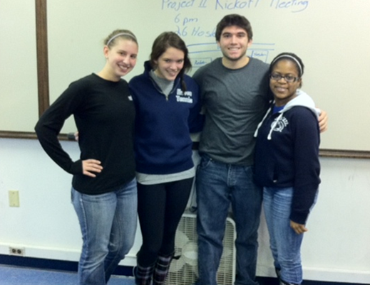
Engineering Design
Notes:
During your freshman year, the majority of engineers have to take EDESIGN. First, you are assigned a team that you work on for the entire year on a series of projects.

Slide 18
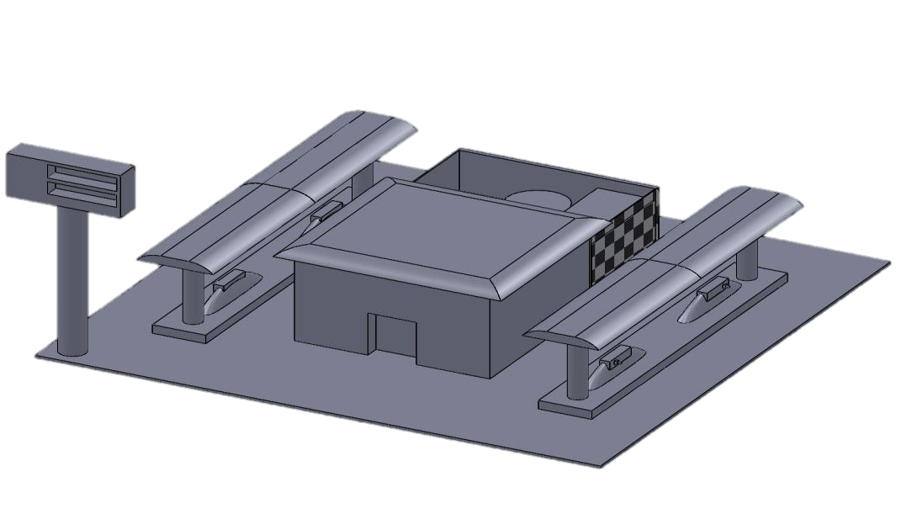
Engineering Design
Notes:
Second, the most important project is the company sponsored design project. My EDESIGN had to create a hydrogen fueling station for air products. This was our CAD design for the project

Slide 19
Engineering Design
Notes:
Finally, learning CAD was one of the individual projects. For my design project I created a Macbook Pro.

Slide 20
Pre-College
Housing
First-Year
Engagement
Involvement Opportunities
Internships and Coops
World Class Engineer
+
PSU Potential
PSU Potential
-
Notes:
Another important part of reaching your full potential is being able to take advantage of the…

Slide 21
Pre-College
Housing
First-Year
Engagement
Involvement Opportunities
Internships and Coops
World Class Engineer
+
PSU Potential
PSU Potential
-
Notes:
…involvement opportunities at Penn state

Slide 22
Getting INVOLVED!
800+ Clubs
Notes:
At Penn State , we have more than 800 clubs available to you. And if a club that you are interested in doesn’t exist, you can create your own!

Slide 23
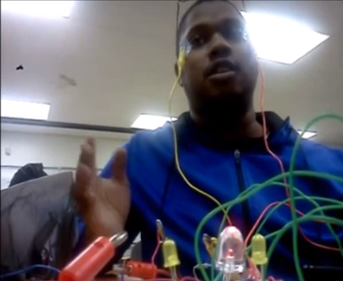
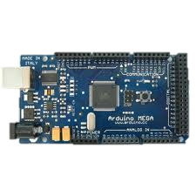
Getting INVOLVED!
Notes:
For example, I have a friend name Aharon. Aharon likes to program and even made a MP3 player that changes the song by his eye movements. Aharon wanted to create a group so he decided to create a group for microcontroller. You can think of it as a mini computer. I’m currently an officer for this group to learn from more people like Aharon.
Then there’s a lot of other groups that you can be a part of that fit your interest.

Slide 24
Pre-College
Housing
First-Year
Engagement
Involvement Opportunities
Internships and Coops
World Class Engineer
+
PSU Potential
PSU Potential
-
Notes:
Once you find the group that fits you, you may way to look at potential options to gain experience…

Slide 25
Pre-College
Housing
First-Year
Engagement
Involvement Opportunities
Internships and Coops
World Class Engineer
+
PSU Potential
PSU Potential
-
Notes:
…through an internship or possibly a co-op.

Slide 26
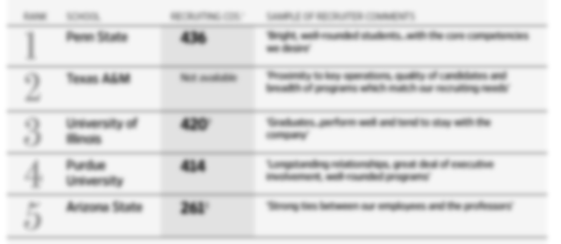
Notes:
Penn State has been ranked #1 for the place to go for recruiters. That means you have a likely chance of getting a job here

Slide 27
Notes:
One of the big events is the Fall Career fair which is located in the Bryce Jordan Center. This fair is the largest in the country. We have hundreds of employers looking to hire Penn State students.

Slide 28
Notes:
Two of the internships that I received happened because of the Fall Career Fair.

Slide 29
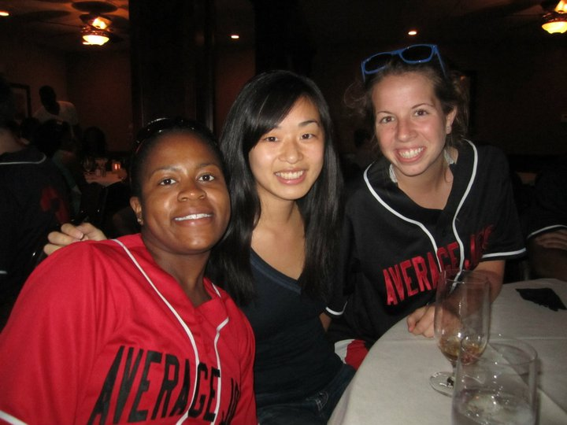
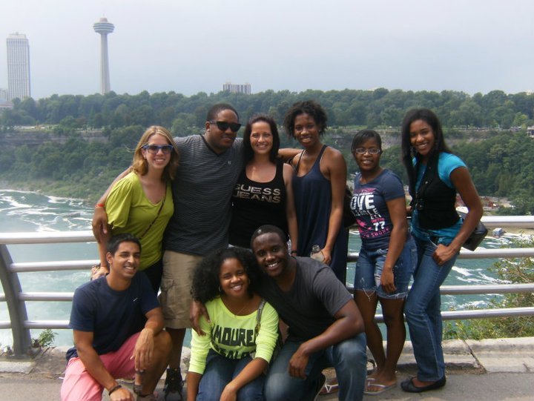
Notes:
During freshman year I interned with Corning. As a freshman I didn’t think it was a big deal, but I had to go because of my first year seminar. I’m happy I did because I had one of the best summers of my life. I confirmed I wanted to do EE, I was on the company softball team, I got to travel, and I was able to just learn from professionals.

Slide 30
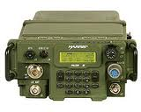
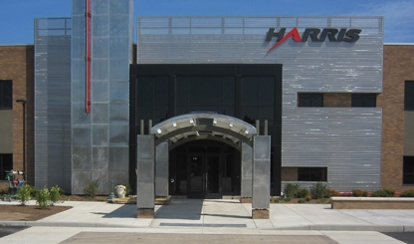
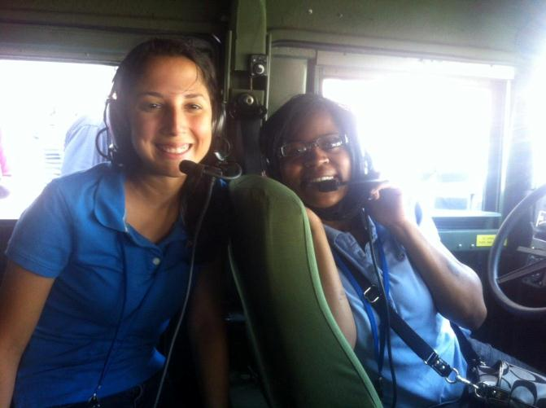
Notes:
Harris Corporation was an internship that I was able to get through the WEP (women in engineering program).

Slide 31
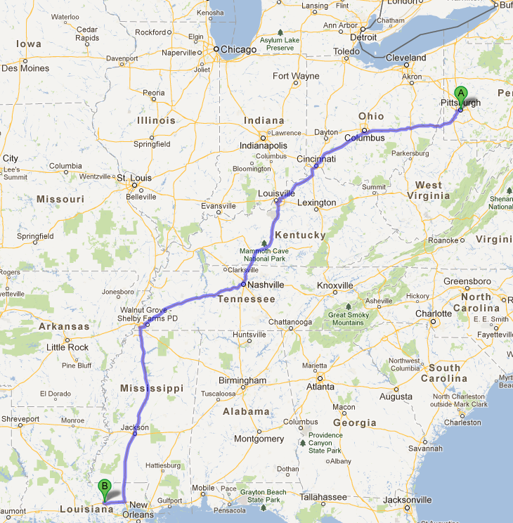
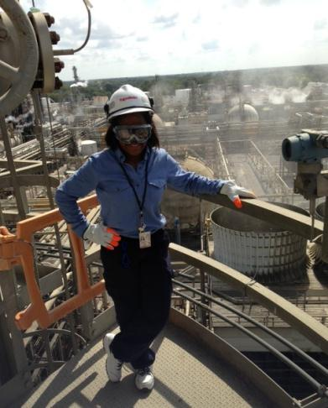
Summer 2013
Notes:
Last summer, I interned with Exxon which was 17 hours away from home for me in Baton Rouge, Lousiana. You’ll see in the picture, me on the top of one of the towers that I had to climb for one of my projects. One thing you should know is that even though it was the morning it was probably 80 degrees outside and I had to wear my flame resistant clothing. So it was kind of hot. But I was able see the top of this huge plant and get the data I needed.
I was able to be in the field more than I was at my desk. Also, getting this internship allowed for me to have a full time job before I started my senior year so I don’t have to worry about a job search.

Slide 32
Pre-College
Housing
First-Year
Engagement
Involvement Opportunities
Internships and Coops
World Class Engineer
+
PSU Potential
PSU Potential
-
Notes:
You have heard my story on some of the great opportunities that Penn State has to offer. Now it’s up to you to your potential, become that world class engineer

Slide 33
Pre-College
Housing
First-Year
Engagement
Involvement Opportunities
Internships and Coops
World Class Engineer
+
PSU Potential
PSU Potential
-
Notes:
Light up the world.

Slide 34
Create. Connect. Change.
Alexis Jackson
atj5040@psu.edu
Visit engr.psu.edu/connect
Notes:
Thank you for your time! Please contact me if you have any questions and make sure to visit us online at engr.psu.edu/connect!

