Slide 1
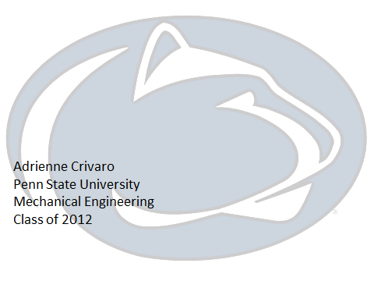
www.trademarxwallcoverings.com
Notes:
This slide is up when I start my presentation. The most important thing to do in an introduction is to establish your credibility and build a relationship with the audience. With a presentation like this, the key elements to include are your name, major, and year in school. Throughout my presentation, you will see a lot of pictures that I am in or that I took. This helped me build a relationship with the audience by opening up about my experiences that I felt comfortable sharing.

Slide 2
upload.wikimedia.org
Notes:
This is my mapping slide. For my college of engineering experience, I used the theme of a puzzle to relate my story back to something relatable to the audience. This is another opportunity to help orient the audience to the issues that I will take about throughout the presentation (such as living options, extracurricular activities, ect). To maintain credibility, the responsibility falls on the presenter to know what topics they will cover. This takes practice to work effectively.

Slide 3
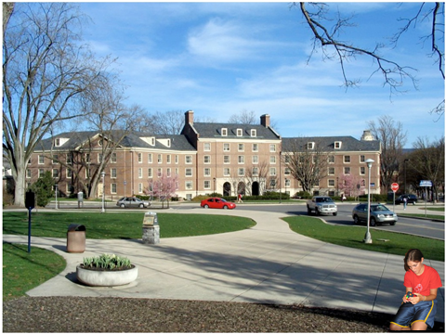
E-House
FYSE
WISE
EASI
www.engr.psu.edu
Notes:
The first topic to cover are the living options on campus. Personally, I lived in one of the special living options, so talking about my experience can give the audience something to relate to and remember. Even if you have not had one of these experiences, try discussing with a friend or acquaintance about their experience to gather stories to tell.

Slide 4
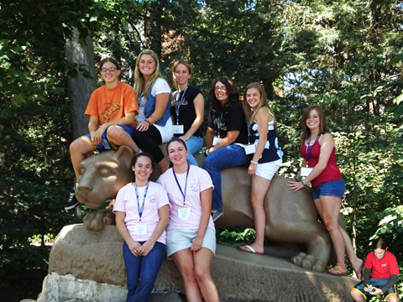
Notes:
This slide covers orientation programs that take place before classes begin. Again, notice the use of a personal photograph to relate my personal experience to the audience. At this point, you may have also noticed the small recurring image in the bottom left corner of the slide. This is a series of pictures of me solving a Rubik’s cube, the puzzle I referenced during the mapping section. As the presentation goes on, the cube gets closer to being solved just like I solve d my college puzzle.

Slide 5
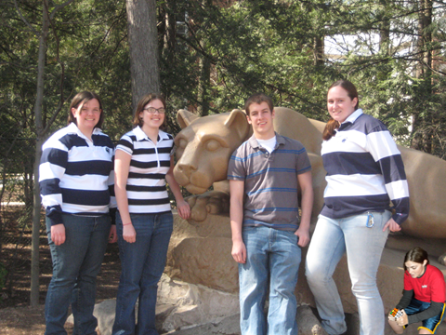
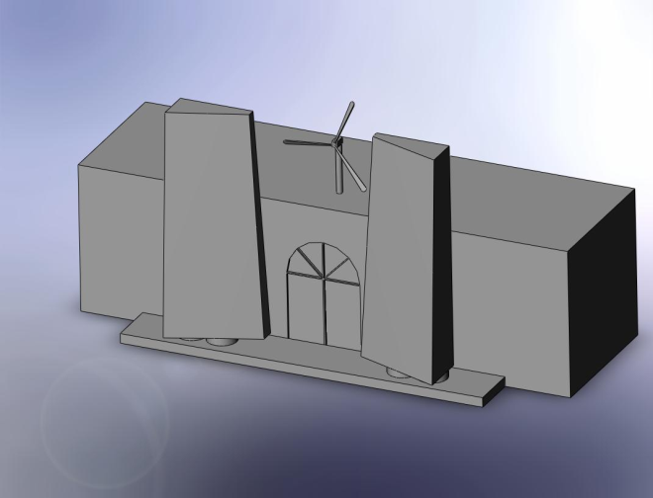
www.personal.psu.edu
Notes:
This slide covers first year experiences.

Slide 6
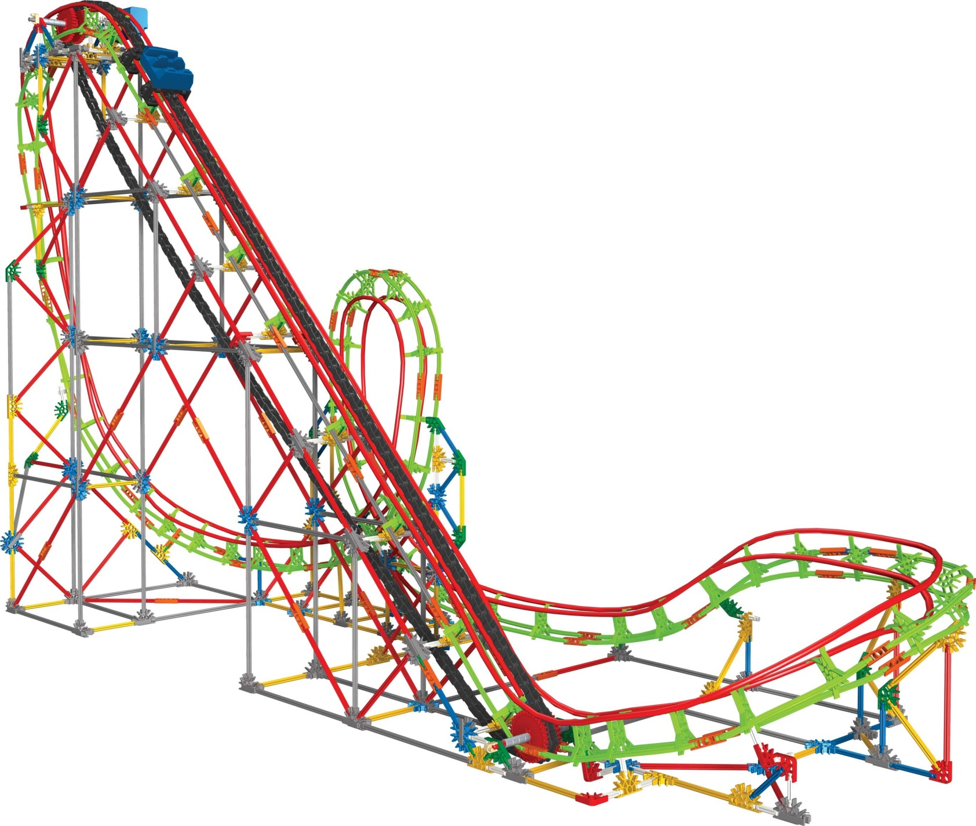
Notes:
This slide covers my switch from aerospace engineering to mechanical engineering. This was a slide that I debated including but I did in the end. I felt that including this help show the audience that I did make a choice that was not best for me. However, even though I made this choice, I went about figuring out what was best and made the changes I needed to continue forward.

Slide 7
Notes:
This slide is about clubs and organizations in engineering. This is where I make the move from discussing classroom topics to things that are more outside of the classroom. There are a large number of organizations that engineers can be a part of and it is impossible to talk about them all. Try listing a few of the organizations with a brief sentence description, then cover one organization in depth and some of the benefits and opportunities you gained from being a part of this group.

Slide 8
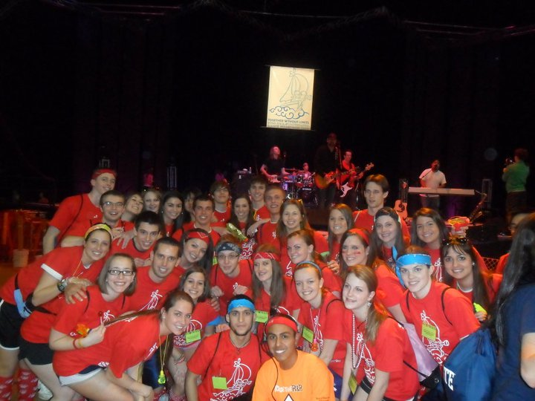
Notes:
This slide talks about organizations outside of the engineering realm. Once again, there are a lot of organizations that cater to a large range of interests. Find something that was important to you and show that to the audience.

Slide 9
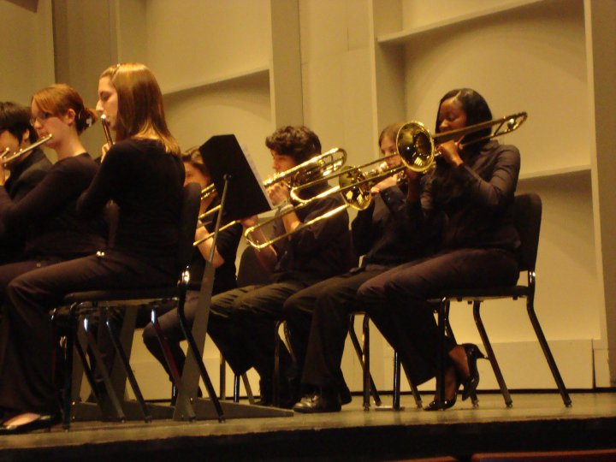
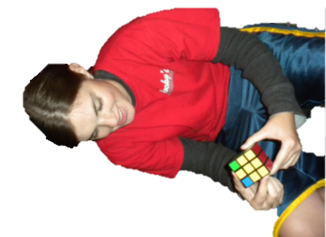
Notes:
This is my last slide about extracurricular activities. This slide aims to show the audience that even though there is a tough engineering curriculum, it is still possible to continue your hobbies and passions and still get course credit for it.

Slide 10
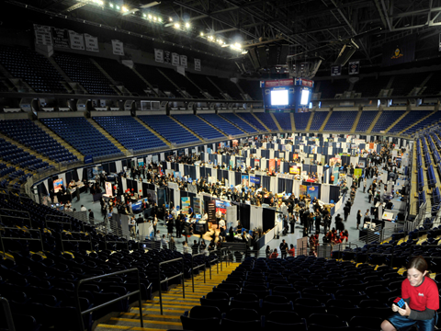
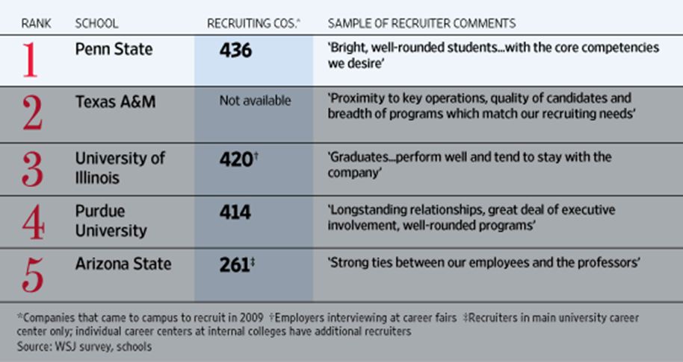
Notes:
This last slide is about the work opportunities available to students throughout their time as a student. This is a good time to talk about any work experiences that you have. It is also important to know about any major studies that are related to your topic. In this case, it is a study from the Wall Street Journal. Familiarize yourself with the study so when you talk about it, the audience can trust you about the results.

Slide 11
QUESTIONS?
Notes:
This last slide ties together all the elements of the presentation. All of these elements came together to solve the puzzle just like we have successfully navigated the presentation.

