Slide 1
Memory Map: Short Technical Talk
LLNL: 12% of US oil
Problem Talk: sources of drag
Solution Talk: way to reduce drag
Limitation: only class 12 semis
1
2
1% improvement → $800 million
3
Original Talk: Casey Howsare
Notes:
The above slide is a memory map that Michael Alley, the author of The Craft of Scientific Presentations, created to help him prepare for delivering a short technical talk (which was originally created by Casey Howsare, a Penn State engineering student). The map contains the talk’s two assertion-evidence slides as well as key details and transitions
In the notes page on the next slide is text that Alley said in this talk. Note that Alley used the map before the talk as a practice aid. Also note that each time he has given the talk, he has fashioned different sentences to communicate the ideas. However, the ideas and their sequence have remained the same.

Slide 2
Blank slide at start of talk
Notes:
Possible spoken text for this blank screen: According to Lawrence Livermore National Laboratory, semi-tractor trailer trucks account for 12 percent of the United States petroleum consumption. That translates to 21 million barrels per day. Clearly, improving the fuel economy of these trucks would have a significant effect on how we conserve our energy resources and reduce vehicular emissions.
Reference: Original talk created by Casey Howsare, a Penn State engineering student.

Slide 3
My research will focus on reducing the aerodynamic drag of semi-tractor trailer trucks to improve fuel economy
[LLNL, 2010]
Notes:
Possible spoken text on this slide: My research will focus on improving the fuel economy of semi-tractor trailer trucks by reducing the aerodynamic drag on these trucks. My problem speech will analyze the sources of aerodynamic drag on semi-tractor trailer trucks and how much energy this drag draws from the truck’s engine. My solution speech will investigate a means to reduce that aerodynamic drag. A limitation of my work is that I will focus on class 12 semi-tractor trailer trucks, which is the most common type of such vehicles and which is shown in the photo on this slide. This photo presents an experiment to observe the flow of air around a semi-tractor trailer truck and in turn assess the aerodynamic drag. This experiment occurred at Lawrence Livermore National Laboratory. While Lawrence Livermore National Lab is certainly a key source for my research, my main source is…[change slide]
Reference: Original talk created by Casey Howsare, a Penn State engineering student.

Slide 4
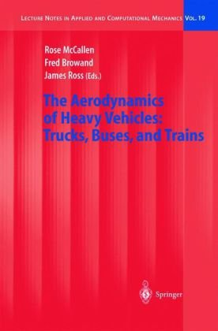
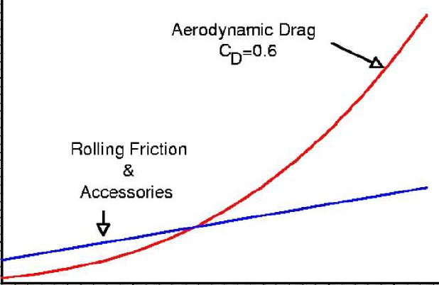
The Aerodynamics of Heavy Vehicles will show how much energy from a semi’s engine is spent on drag
Drag
Rolling friction
Engine’s energy
Dr. Rose McCallen
Lawrence Livermore National Lab
Vehicle speed
4
Notes:
Possible spoken text on this slide: …the book The Aerodynamics of Heavy Vehicles: Trucks, Buses, and Trains. This book is a actually collection of keynote papers from conferences. As you might know, keynote papers are invited conference talks by leading experts in a field. Shown on the right part of the slide is an example of the information this text contains. This simplified version of a graph from the book shows how the amount of engine energy needed to overcome drag. That amount of energy depends on vehicle speed. This relationship is important in my problem speech.
[Animation] Dr. Rose McCallen from Lawrence Livermore National Lab is the lead editor of this book. She is the Project Leader for DOE’s Heavy Vehicle Aerodynamics Project. Dr. McCallen joined LLNL in 1981. She has a Ph.D. in Mechanical Engineering in 1993 from the University of California, Davis. She also holds two B.S. degrees: one in Mechanical Engineering from California State University, Chico, and the other in Mathematics from St. Mary’s College of California. Because of her background in mechanical engineering and computations, she is well suited for my study.
Reference: Original talk created by Casey Howsare, a Penn State engineering student.

Slide 5
Blank slide at end of talk
Notes:
Possible spoken text for this blank screen: In summary, my proposed topic is on reducing the aerodynamic drag of semi-tractor trailer trucks. Reducing this drag could improve the fuel economy of these vehicles, which in turn would affect petroleum consumption and vehicular emissions in the United States. The potential benefit for this improvement of fuel economy is impressive. Just a 1 percent improvement in fuel economy of these trucks would translate into more than $800 million savings in our country. Thank you.
Reference: Original talk created by Casey Howsare, a Penn State engineering student.

