Slide 1
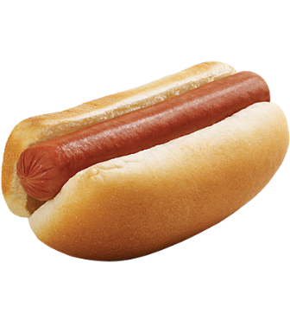
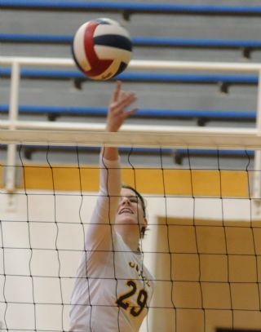
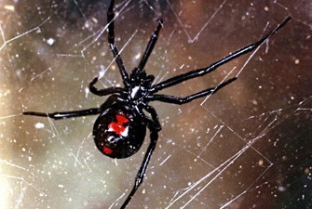
Tori Vadyak
WEPO
ChE
As far as her
education
Summit Hill
In her work experience
detests
On a personal level
fears
Memory Map:
Michael Alley
Notes:
The above slide is a memory map that Michael Alley, the author of The Craft of Scientific Presentations, created to help him prepare for delivering an introduction of Tori Vadyak, who at the time was an engineering undergraduate at Pennsylvania State University. The map contains not only the organization of the talk into three section, but also key words for transitions and images representing the most important details.
In the notes page on the next slide is text that Alley said in the speech of introduction. Note that Alley used the map before the talk as a practice aid. Also note that each time he gave the speech, he fashioned different sentences to communicate the ideas. However, the ideas remained the same.

Slide 2
Tori Vadyak
WEPO
ChE
As far as her
education
Summit Hill
In her work experience
detests
On a personal level
fears
Notes:
Possible Text for Introduction: Today I have the pleasure of introducing to you Tori Vadyak. As far her education, after graduating from high school four years ago, Tori made the trek from her hometown of Summit Hill to Penn State at University Park. Here, she studied chemical engineering and has been active in a number of organizations. For instance, Tori served on the 2014 leadership team of WEPO with her emphasis being alumni relations. In addition, she has been a strong mentor in Utree, teaching not only class periods to first-year students, but also teaching class periods and workshops to juniors, seniors, and even graduate students. This past summer, she presented two papers about Utree in Indianapolis at the Annual Conference for the American Society for Engineering Education.
In her work experience, Tori has had two summer internships with Air Products Corporation, the first one in Hometown, Pennsylvania, and the second one in Allentown. What Tori particularly liked about those experiences was that she could see what the distillation columns and heat exchangers of her textbooks looked like in real life. Tori enjoyed her experiences at Air Products so much that she has accepted a full-time position with the company.
On a personal perspective, Tori is an avid volleyball player. She enjoys reading, with A Thousand Splendid Suns by the author of Kite Runner being a recent book that stands out. However, there are a couple of things that you should know about Tori should you dine or travel with her. She detests hot dogs and fears spiders.
For the past four years, I have had the honor of knowing Tori through three courses and through Utree. In that time, her energy, her thoughtful insights, and her infectious positive attitude have enriched my Penn State experience. I am pleased to present to you—Tori Vadyak.

